Slide 1
Object Detection
Justin Cheng Enrico Zoboli
Notes:
Good evening everyone, tonight Justin and I would like to talk to about Object detection
1

Slide 2
Problem Statement
Object detection is a crucial part of any visual system that seeks to interact with the environment that it perceives.
Object detection can be performed in a variety of ways
In our project, we used Machine Learning algorithms to identify objects within an image
There are multiple ways a machine learning algorithm can take apart an image and decipher its contents
In our project, we attempted object detection with two methods:
Mask-RCNN
YOLO
Notes:
First, let’s define object detection in general a little bit. Object detection is fundamental in any system that wants to see and interact with its surroundings.
Over the past years, there have been many methods to achieve object detection.
For our project, we decided to use machine learning algorithms to identify objects in a provided image.
Amongst the variety of machine learning algorithms available we decided to attempt using Mask-RCNN and YOLO.
2

Slide 3

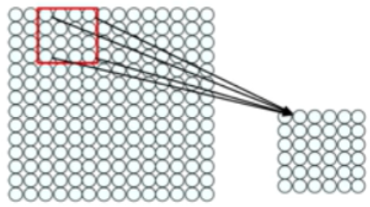
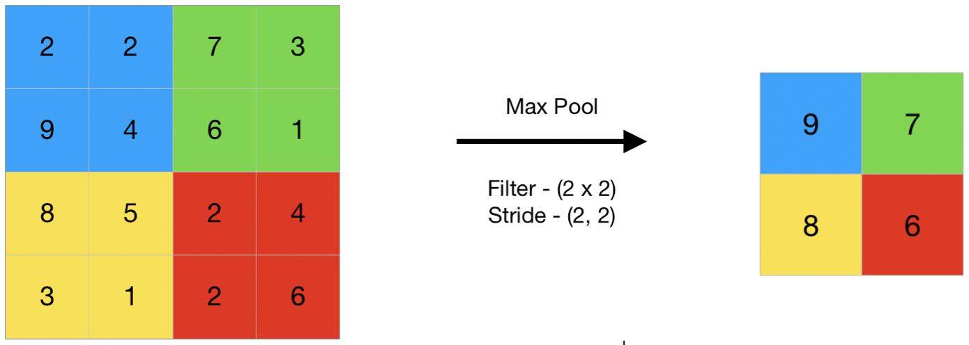
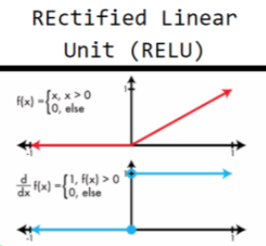
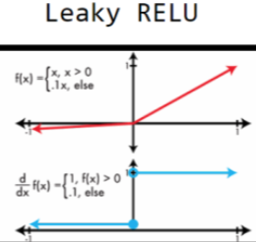
Background: CNN
CNN (Convolutional Neural Network)
Convolution Layer
Feature extraction
Take kernel of specified size, provide a stride to move across the image to get “weights” for each section of the image to detect “features”
Matching of features (filtering) is done by multiplying image pixels by feature pixels, summing them, and then dividing by pixels in feature
Results in stack of images
Pooling Layer
Reduces the size of the stack of the images with window of a specified size
This window scans sections of the Convolution layer images to obtain max in each window
Normalization
Prevent crash by normalizing values -> normal distribution
Negative values become 0
Rectified Linear Units (ReLU)
Notes:
Before we get to our Mask-RCNN and YOLO I would like to talk about Convolutional Neural Networks first.
A CNN is made out of multiple convolutional layers, which is where a filter is applied to an input image to create a feature map that summarizes the presence of detected features in the input.
This way we can extract features from the picture. For example, we take a kernel of specified size, then we move the kernel across the image to obtain different “weights” for each section out of which we can detect features.
Matching feature together is done by multiplying by dot product the image pixels by feature pixels, summing them, and diving them by the amount of pixels in the feature. This results in a stack of images.
After going through convolution we have the pooling layer, which essentially reduces the size of the stack of images by picking those with the highest value in the window.
To make sure the process works correctly, we also have to normalize the values through normal distribution so that we won’t have any negative values.
To make this easier, we can use Rectified Linear Units, as defined in the picture below.
3

Slide 4
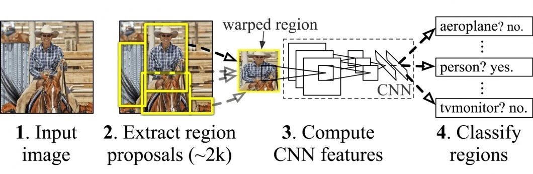
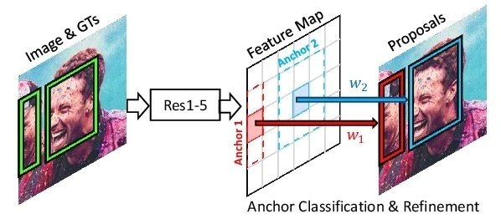
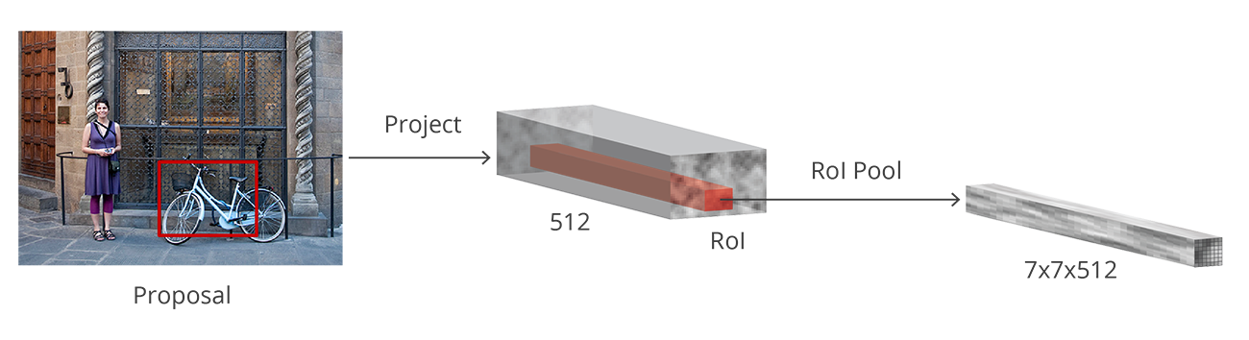
Background: Different CNN application
R-CNN (Region-Based Convolutional Neural Network)
CNNs can produce a large amount of areas to search if the image is large, resulting in very long computation time
R-CNN aims to reduce the amount of time taken to compute by selecting regions of interest (2000) from the image
CNN is run on those regions of interest
Fast R-CNN
CNN is run once and then applied to all 2000 regions
Creates convolutional feature maps, that are then fed to ROI Pooling Layer to make sure they are all the same size
ROIs are then fed to network for clarification
Faster R-CNN
RPN is a neural network that recommends regions of interest
Notes:
To further increase the efficiency of CNN, the Region-Based Convolutional Neural Network, or R-CNN was developed.
Essentially the R-CNN method first divides the image into regions of interest (usually 2000), and then runs the CNN for each region, making the whole image processing faster
A further improvement is the Fast R-CNN, in which CNN is run once and then applied to all regions. This creates convolutional features maps that are then fed into the region of interest pooling layer to make them all the same size
The Regions of Interest are then fed to the network for clarification and to properly identify each object.
Finally, the Faster R-CNN uses Region Proposal Network which is a fully convolutional network that simultaneously predicts object bounds and objectness scores at each position.
4

Slide 5
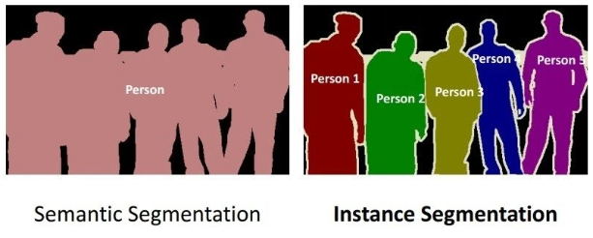
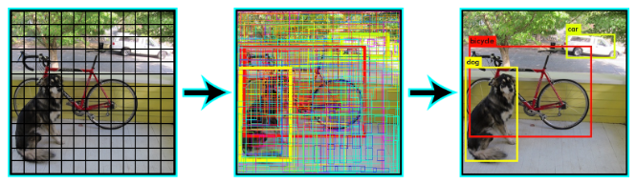
Background: Different CNN application (contd.)
Mask R-CNN
Based on Faster R-CNN
Uses “masks” to separate the categories of objects from the background
It then separates each category into the individual objects
YOLO
Unlike previous methods it doesn’t create proposals
Yolo divides the picture into multiple, overlapping cells
It then selects the cell with the greatest probability score and suppresses the surrounding cells
The step is repeated until all bounding boxes are obtained
Notes:
5

Slide 6


Pipeline - Machine Learning Model
For our Machine Learning Library, we used Keras
Keras is a Deep Learning Python API that provides an open source interface for neural networks
The neural network library that is used is TensorFlow, which is a open source machine learning library originally developed by Google.
Notes:
For the machine learning model we mostly used two sources.
The first one is Keras, a deep learning python API that provides an open source interface for neural networks.
While the second one is Tensorflow, a neural network library developed by Google
6

Slide 7

Pipeline - CNN libraries
For Object Detection we used the following libraries:
https://github.com/matterport/Mask_RCNN
https://github.com/experiencor/keras-yolo3
Notes:
Finally, for the complete object detection we used the following libraries on Github, with the first one being Matterport for Mask R-CNN and experiencecor for Yolo3 on Keras
7

Slide 8
Solution Method
Instantiate Keras model
Train Model with Library
Provide Image to Trained Model to detect object
1
2
3
Notes:
From a very high level, our method first initiates the Keras model, it then trains the model with the keras library, and finally we provide the image to the trained model to detect the objects.
Now Justin will go further into detail about the code.
8

Slide 9
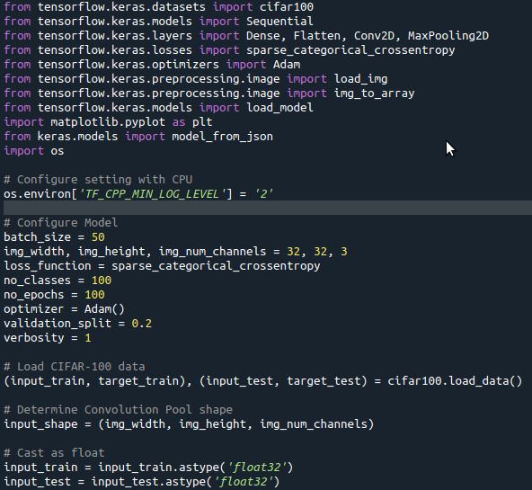
Solution Method: Mask-RCNN
Import libraries to use Keras library
Define model parameters
Width, height, and channels (BGR) of images in convolution layer
Classes of clarification
Epochs
Notes:
9

Slide 10
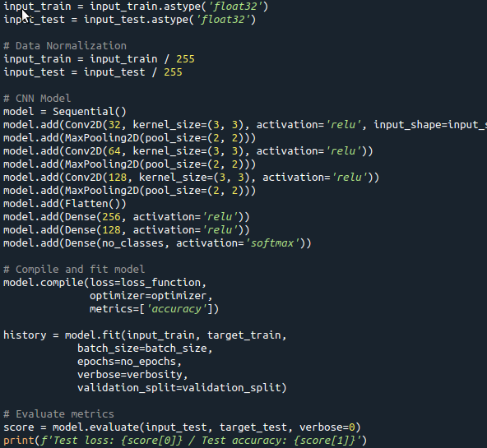
Solution Method
Normalize data by dividing by 255 (255 is the max value of the pixels)
Model is sequence of Convolution Layers and Pooling Layers
Train model by compiling model, fitting it, and then iterating it through specified amount of epochs in configuration of model
Notes:
10

Slide 11
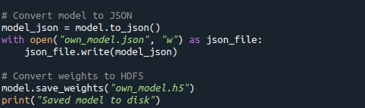
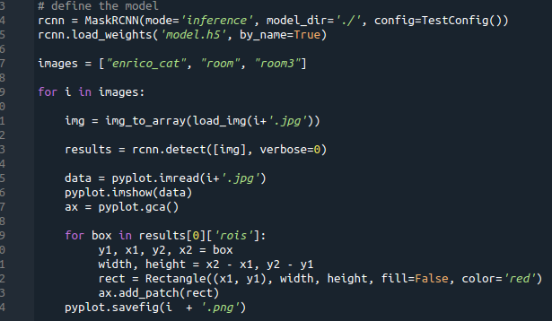
Solution Method
Save weights of model HDF5 format
Load weights to MaskRCNN object that will detect objects in room based on weights
Iterate through results to put detected bounding boxes over original image
Notes:
11

Slide 12
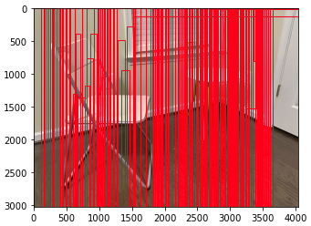
Results
Mask RCNN Results - Before good training and getting correct weights
Notes:
12

Slide 13
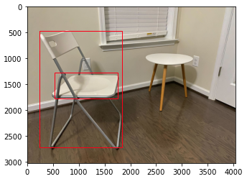
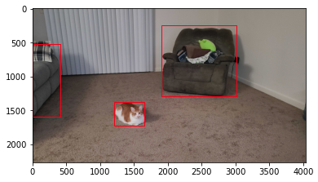
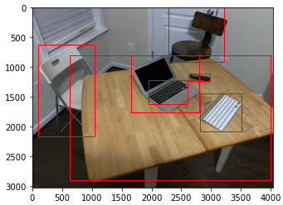
Results
Mask RCNN Results
Notes:
13

Slide 14
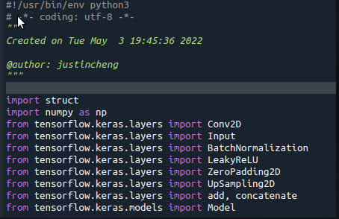
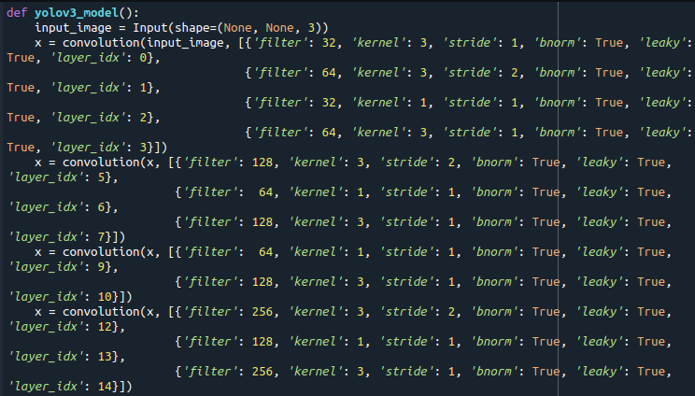
Solution Method: YOLO
Import libraries to use Keras library
Define model parameters
Width, height, and channels (BGR) of images in convolution layer
Number of Layers
Notes:
14

Slide 15
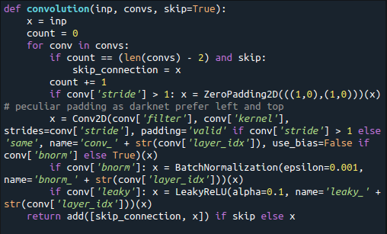
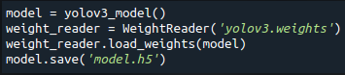
Solution Method: YOLO
Function for creating the convolution layers.
Model is sequence of Convolution Layers and Pooling Layers
Creation of the actual model using provided weights.
Weights are from MSCOCO dataset.
Notes:
15

Slide 16
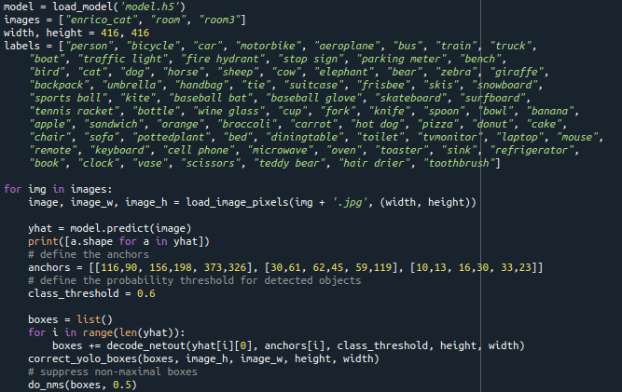
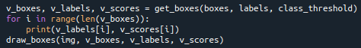
Solution Method: YOLO
Provide dimensions and classes associated with the model.
Model makes a prediction of bounding boxes based on anchors and a likeliness threshold for filtration
Get the remaining boxes after filtration, correction, and overlap merging.
Draw boxes onto original image
Notes:
16

Slide 17
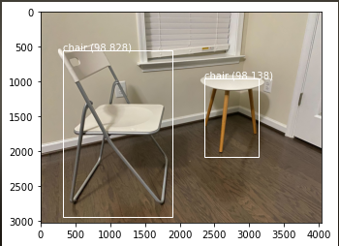
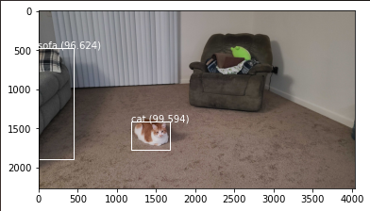
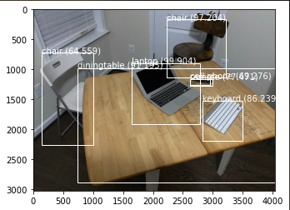
Results
YOLO Results
Notes:
17

Slide 18
Conclusions
We achieved object detection by using publicly available libraries
Mask RCNN appears to be less accurate than YOLO as it stands.
This might have to do with how we train the model for the CNN
There is still work to be done to create our own
Notes:
18

Slide 19
Lessons Learned
Neural Networks are an amazing achievement of mankind
Notes:
19

